Slide 1
Jose’s Health Data Cavalcade Extravaganza!
With supporting roles from:
Mirana Chavez, Dwight Mauk, Robert Mabry

Slide 2
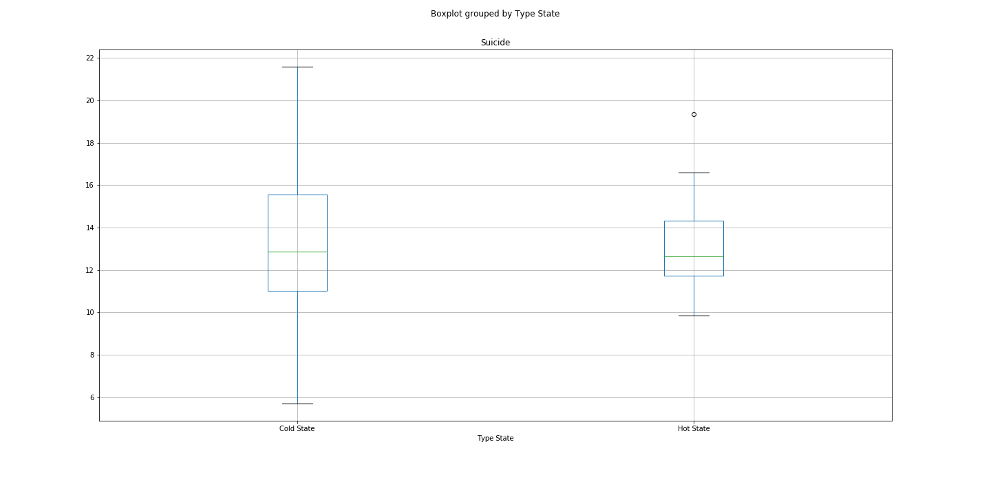
Suicide by State (Hot vs Cold)

Slide 3
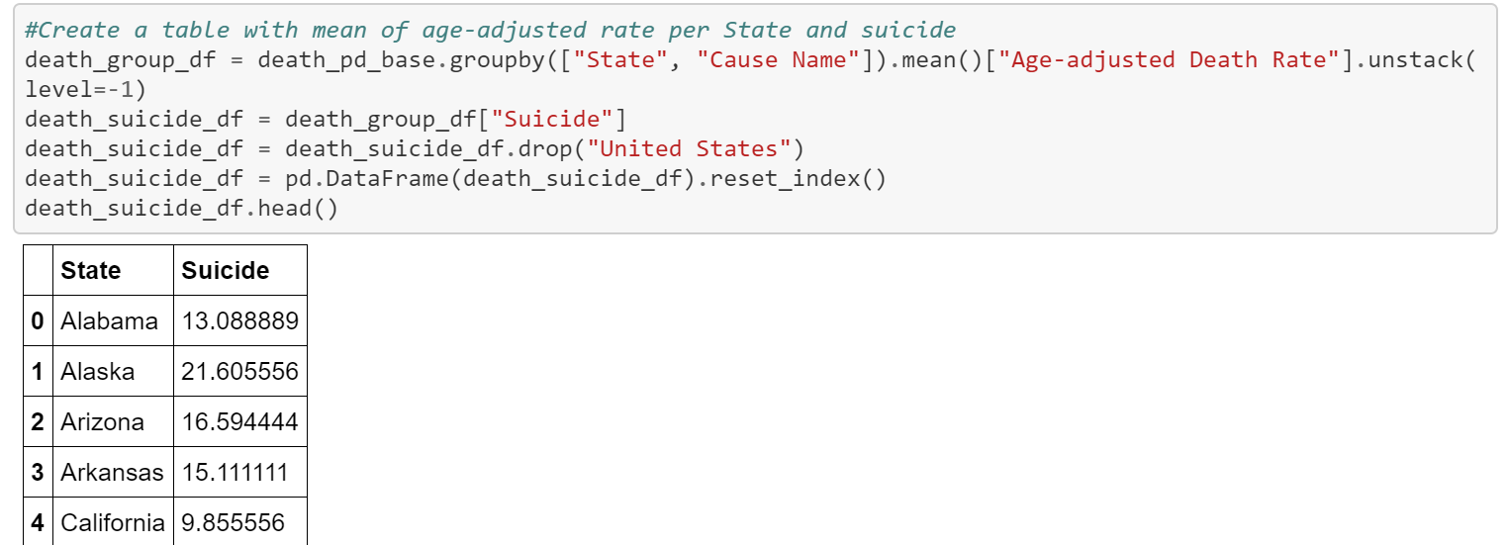
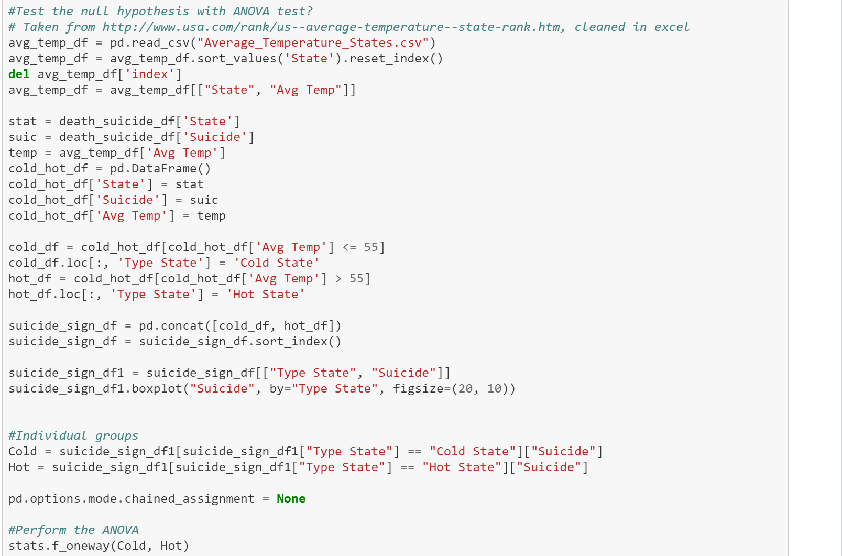
Code and Analysis

